Slide 1
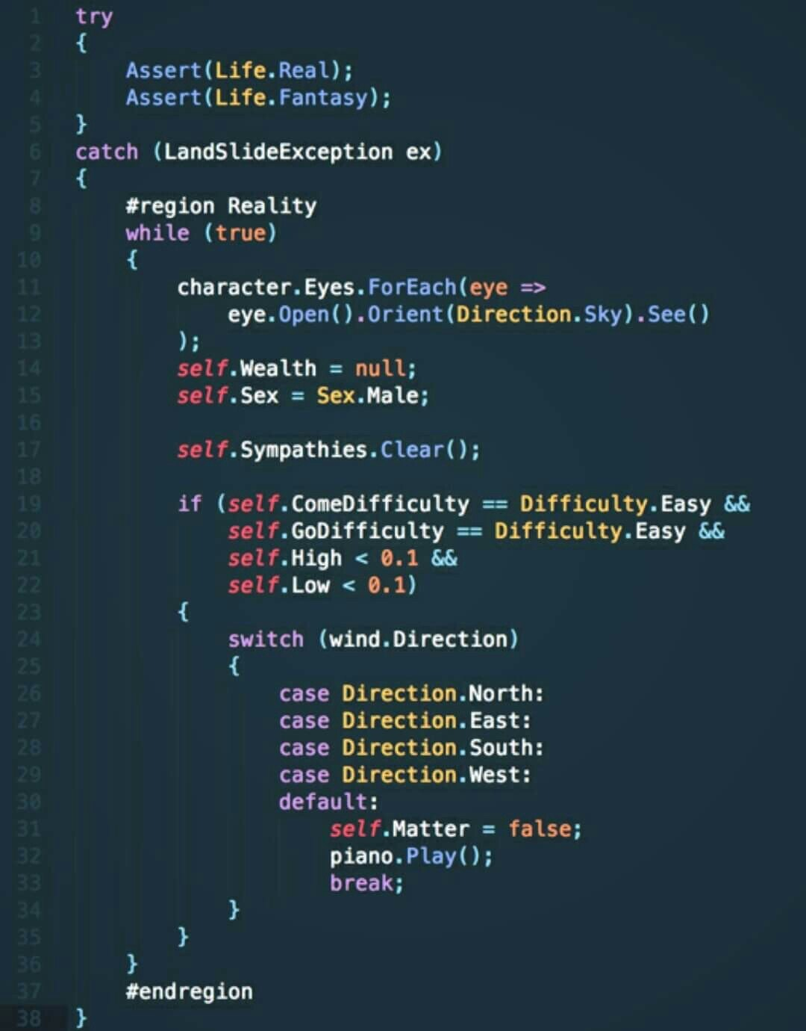
The road to being a Computer Scientist…
“The journey of a thousand miles begins with a one step” – Lao Tzu
Starting out
Become a lifelong learner
Understand your future role
Writing pseudocode
Start with pseudocode
Tweak the pseudocode
Writing algorithms
Try writing algorithms for all sorts of things
After you've learned how to write algorithms, programming should come naturally to you.
Programming is only the translation of pseudocode into a programming language.
Analyze algorithms

Slide 2
Program Design Essentials
Understand the tasks that the program is to perform.
Determine the steps that must be taken to perform the task
Create an algorithm
Use flowcharts and/or pseudocode.

Slide 3

A Protocol to Solving Problems
Analyze the problem
Work out concrete examples; make note of boundary cases
Brainstorm about the problem
Design the algorithm
Analyze the algorithm
Write the solution
Revise
Reflect
Generalize
Learn about the history and applications

Slide 4

Goals
Apply basic algorithmic paradigms to solve problems
Write algorithms with precision, logical coherence, and rigor
Analyze easy algorithms, and
Parse rigorously written material

Slide 5

Problem: A Fake among Eight Coins
There are eight identical-looking coins; one of these coins is
counterfeit and is known to be lighter than the genuine coins.
What is the minimum number of weighings needed to identify
the fake coin with a two-pan balance scale without weights?

Slide 6
Solution: A Fake among Eight Coins [1/2]
Divide the coins into three groups of 3, 3, and 2 coins each
Call them L, R, and E respectively.
Use the two-pan balance to compare the weights of the groups L and R.
If they weigh the same, the fake coin can neither be in L nor in R, so it must be in E.
Take the two coins in E and compare them. The lighter coin (between the two coins in E) must be the fake coin.

Slide 7
Solution: A Fake among Eight Coins [2/2]
6. If the weights of L and R are different, then the fake coin must be in the group that is lighter.
7. Take any 2 coins from this group and weigh them. If they weigh the same then the remaining coin in the group must be fake.
8. If one of them is lighter, the lighter coin must be the fake coin.
9. In all cases, we identified the counterfeit with two comparisons.

Slide 8
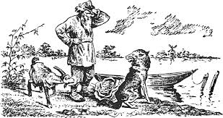
Problem: A Wolf, a Goat and a Cabbage
A man finds himself on a riverbank with a wolf, a goat, and a head of cabbage. He needs to transport all three to the other side of the river in her boat. However, the boat has room for only the man himself and one other item (either the wolf, the goat, or the cabbage).
In his absence, the wolf would eat the goat, and the goat would eat the cabbage. Show how the man can get all these passengers to the other side.

Slide 9

Problem: Glove Dissection
There are 20 gloves in a drawer: 5 pairs of black gloves, 3 pairs of brown, and 2 pairs of gray.
You select the gloves in the dark and can check them only after a selection has been made.
What is the smallest number of gloves you need to select to guarantee getting the following?
At least one matching pair
At least one matching pair of each color

Slide 10
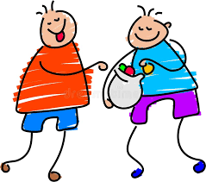
Problem: Candy Sharing
In a kindergarten, there are n children sitting in a circle facing their teacher in the center. Each child initially has an even number of candy pieces. When the teacher blows a whistle, each child simultaneously gives half of his or her candy pieces to the neighbor on the left. Any child who ends up with an odd number of pieces is given another piece by the teacher. Then the teacher blows her whistle again, unless all the children have the same number of candies, in which case the game stops. Can this game go on forever or will it eventually stop to let the children go on with their lives?

Slide 11
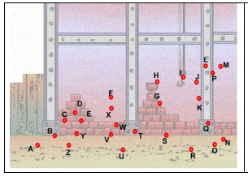
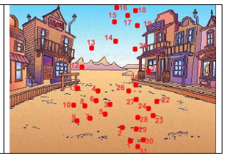
Problem: DM Me
You have been given a collection of points, like the ones shown in the typical puzzles attached, and you have to send this information to a friend located far away from you. Both of you have a communicating device which only allows you to send numbers (no words or symbols at all). You know that, if the dots are connected, you get a recognizable figure, but there is no way for you to send its name, only the points. How can you transmit the very same sequence of points in such way that your friend can reconstruct the figure??

